Slide 1


PYTHON
The programming LANGUAGE

Slide 2
What is Python?
Python was created by Guido van Rossum, and first released on February 20, 1991.
Python is a high-level, general-purpose programming language. Its design philosophy emphasizes code readability with the use of significant indentation via the off-side rule. Python is dynamically typed and garbage-collected.
Designed by: Guido van Rossum
Developer: Python Software Foundation
First appeared: 20 February 1991; 32 years ago
OS: Windows, macOS, Linux/UNIX, Android and more
Paradigm: Multi-paradigm: object-oriented, procedural (imperative), functional, structured, reflective

Slide 3
Why python?
Python is used for:
Web Development (server-side)
Software Development
Mathematics
System Scripting
Python works on different platforms (Windows, Mac, Linux, Raspberry Pi, etc).
Python has a simple syntax similar to the English language.
Python has syntax that allows developers to write programs with fewer lines than some other programming languages.
Python runs on an interpreter system, meaning that code can be executed as soon as it is written. This means that prototyping can be very quick.
Python can be treated in a procedural way, an object-oriented way or a functional way.

Slide 4
What can Python do?
Python can be used on a server to create web applications.
Python can be used alongside software to create workflows.
Python can connect to database systems. It can also read and modify files.
Python can be used to handle big data and perform complex mathematics.
Python can be used for rapid prototyping, or for production-ready software development.

Slide 5
Good to know
The most recent major version of Python is Python 3, which we shall be using in this tutorial. However, Python 2, although not being updated with anything other than security updates, is still quite popular.
In this tutorial Python will be written in a text editor. It is possible to write Python in an Integrated Development Environment, such as Jupyter, Thonny, Pycharm, Visual Code, Netbeans or Eclipse which are particularly useful when managing larger collections of Python files.

Slide 6
Python vs other programming languages
Python was designed for readability, and has some similarities to the English language with influence from mathematics.
Python uses new lines to complete a command, as opposed to other programming languages which often use semicolons or parentheses.
Python relies on indentation, using whitespace, to define scope; such as the scope of loops, functions and classes. Other programming languages often use curly-brackets for this purpose.

Slide 7
Python keywords or reserve words
Keywords in Python Programming Language
False | await | else | import | pass
None | break | except | in | raise
True | class | finally | is | return
and | continue | for | lambda | try
as | def | from | nonlocal | while
assert | del | global | not | with
async | elif | if | or | yield
The above keywords may get altered in different versions of Python. Some extra might get added or some might be removed. You can always get the list of keywords in your current version by typing the following in the prompt.

Slide 8
Python shell
To start the Python shell, simply type
python and hit Enter in the terminal:
D:\IIG\PythonTest>python
Python 3.11.3 (tags/v3.11.3:f3909b8, Apr 4 2023, 23:49:59) [MSC v.1934 64 bit (AMD64)] on win32
Type "help", "copyright", "credits" or "license" for more information.
>>>
Type the following lines to display the list of supported Python keywords:
>>> import keyword
>>> print(keyword.kwlist)
['False', 'None', 'True', 'and', 'as', 'assert', 'async', 'await', 'break', 'class', 'continue', 'def', 'del', 'elif', 'else', 'except', 'finally', 'for', 'from', 'global', 'if', 'import', 'in', 'is', 'lambda', 'nonlocal', 'not', 'or', 'pass', 'raise', 'return', 'try', 'while', 'with', 'yield’]
>>>

Slide 9
Python shell - 2
print('The sum is %.1f' %(float(input('Enter first number: ')) + float(input('Enter second number: '))))
Type the snippet
>>> print('The sum is %.1f' %(float(input('Enter first number: ')) + float(input('Enter second number: '))))

Slide 10
Python data types - 1
Data Types | Classes | Description
Numeric | int, float, complex | holds numeric values
String | str | holds sequence of characters
Sequence | list, tuple, range | holds collection of items
Mapping | dict | holds data in key-value pair form
Boolean | bool | holds either True or False
Set | set, frozenset | hold collection of unique items
Binary | bytes, bytearray, memoryview
None | None Type
Since everything is an object in Python programming, data types are actually classes and variables are instances(object) of these classes.

Slide 11
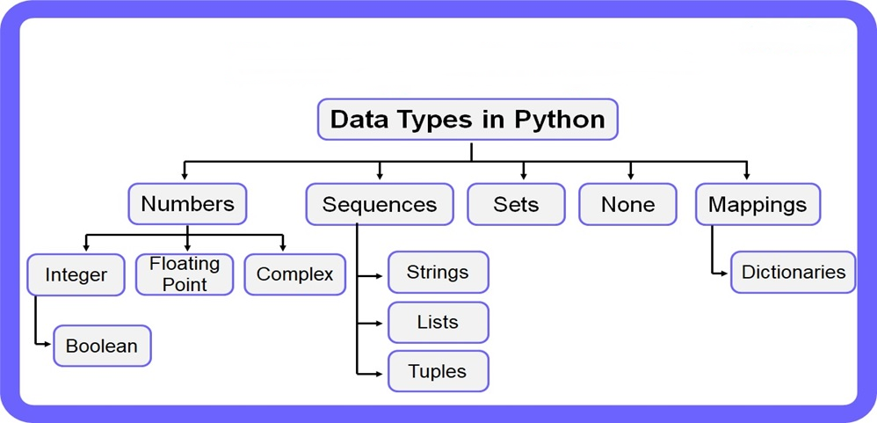
Python data types - 2

Slide 12
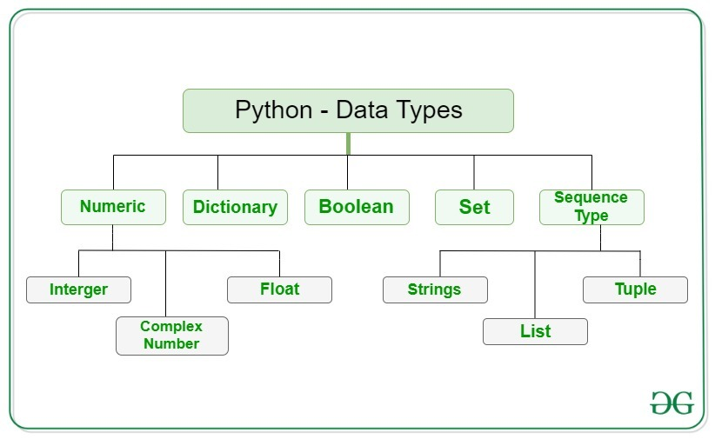

Slide 13
Numeric data types
num1 = 5
print(num1, 'is of type', type(num1))
num2 = 2.0
print(num2, 'is of type', type(num2))
num3 = 1+2j
print(num3, 'is of type', type(num3))
5 is of type <class 'int’>
2.0 is of type <class 'float’>
(1+2j) is of type <class 'complex'>

Slide 14
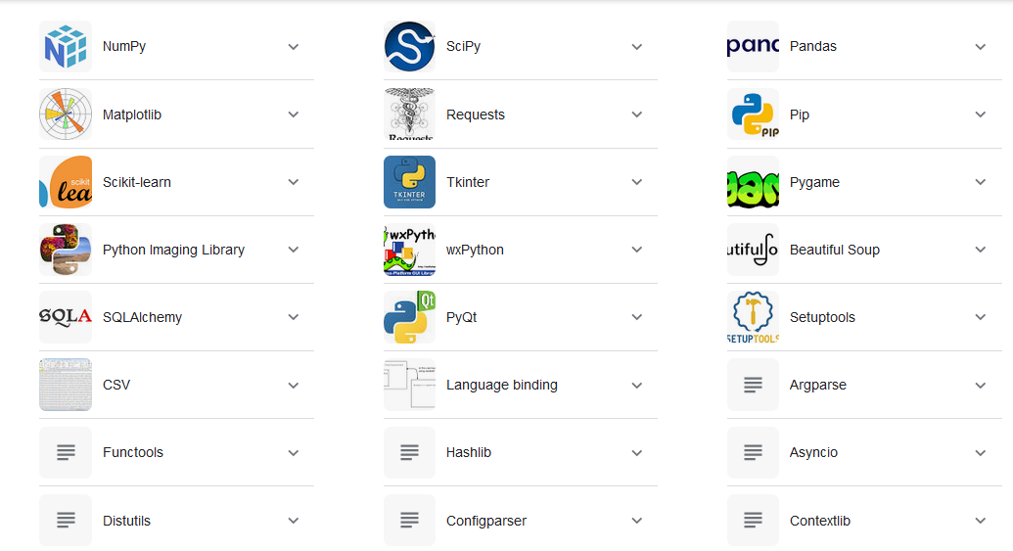
Python modules

Slide 15
Rules for Creating a variable
A variable can have a short name (like x and y) or a more descriptive name (age, carname, total volume).
Rules for Python variables:
A variable name must start with a letter or the underscore character
A variable name cannot start with a number
A variable name can only contain alpha-numeric characters and underscores (A-z, 0-9, and _ )
Variable names are case-sensitive (age, Age and AGE are three different variables)
A variable name cannot be any of the Python keywords.

Slide 16
Examples of variable names
Legal variable names:
myvar = "John" my_var = "John" _my_var = "John" myVar = "John" MYVAR = "John" myvar2 = "John"
Illegal variable names:
2myvar = "John" my-var = "John" my var = "John"
Camel case variable names:
myVariableName = "John“
Pascal case variable names:
MyVariableName = "John“
Snake case variable names:
my_variable_name = "John"

Slide 17
Python valid variable assignment
Many Values to Multiple Variables:
x, y, z = "Orange", "Banana", "Cherry"
print(x)
print(y)
print(z)
One Value to Multiple Variables:
x = y = z = "Orange"
print(x)
print(y)
print(z)
Unpack a Collection:
fruits = ["apple", "banana", "cherry"]
x, y, z = fruits
print(x)
print(y)
print(z)

Slide 18
Global variables
The variables that are created outside of a function
Global variables can be created both inside and outside of functions
x = "awesome"
def myfunc():
print("Python is " + x)
myfunc()
If you use the global keyword, the variable belongs to the global scope:
def myfunc():
global x
x = "fantastic"
myfunc()
print("Python is " + x)

Slide 19
Escape Characters
Slno | Code | Result
1 | \' | Single Quote
2 | \\ | Backslash
3 | \n | New Line
4 | \r | Carriage Return
5 | \t | Tab
6 | \b | Backspace
7 | \f | Form Feed
8 | \ooo | Octal value
9 | \xhh | Hex value

Slide 20
Types of operators
Python divides the operators in the following groups:
Arithmetic operators
Assignment operators
Comparison operators
Logical operators
Identity operators
Membership operators
Bitwise operators

Slide 21
Python exception handling
There are 5 keywords associated with exception handling
The try block lets you test a block of code for errors.
The except block lets you handle the error.
The else block lets you execute code when there is no error.
The finally block lets you execute code, regardless of the result of the try- and except blocks.
The raise keyword can generate an exception.

Slide 22
Exception handling example

Slide 23
File handling
A file handling is done with the following operation:
Open a file
Read or write - Performing operation
Close the file
Python provides an open() function that accepts two arguments, file name and access mode
open(<file-name>, <access-code>)

Slide 24
Access-code
SN | Access mode | Description
1 | r | It opens the file to read-only mode. The file pointer exists at the beginning. The file is by default open in this mode if no access mode is passed.
2 | rb | It opens the file to read-only in binary format. The file pointer exists at the beginning of the file.
3 | r+ | It opens the file to read and write both. The file pointer exists at the beginning of the file.
4 | rb+ | It opens the file to read and write both in binary format. The file pointer exists at the beginning of the file.
5 | w | It opens the file to write only. It overwrites the file if previously exists or creates a new one if no file exists with the same name. The file pointer exists at the beginning of the file.
6 | wb | It opens the file to write only in binary format. It overwrites the file if it exists previously or creates a new one if no file exists. The file pointer exists at the beginning of the file.
7 | w+ | It opens the file to write and read both. It is different from r+ in the sense that it overwrites the previous file if one exists whereas r+ doesn't overwrite the previously written file. It creates a new file if no file exists. The file pointer exists at the beginning of the file.
8 | wb+ | It opens the file to write and read both in binary format. The file pointer exists at the beginning of the file.
9 | a | It opens the file in the append mode. The file pointer exists at the end of the previously written file if exists any. It creates a new file if no file exists with the same name.
10 | ab | It opens the file in the append mode in binary format. The pointer exists at the end of the previously written file. It creates a new file in binary format if no file exists with the same name.
11 | a+ | It opens a file to append and read both. The file pointer remains at the end of the file if a file exists. It creates a new file if no file exists with the same name.
12 | ab+ | It opens a file to append and read both in binary format. The file pointer remains at the end of the file.

Slide 25
File open() example
try:
fileptr = open("file.txt")
# perform file operations
finally:
fileptr.close()
# opens the file file.txt in read mode
fileptr = open("file.txt","r")
if fileptr:
print("file is opened successfully")
#closes the opened file
fileptr.close()
with open("file.txt",'r') as f:
content = f.read();
print(content)

